Slide 1


Scrum Framework: A Comprehensive Overview
Scrum is an Agile framework designed to help teams collaborate effectively on complex projects more so in Software Development.

Slide 2
Introduction to Scrum
Definition
Origin
Core Idea
Agile framework used for managing and completing complex projects.
Introduced in the 1980s by Hirotaka Takeuchi and Ikujiro Nonaka and formalized for software development by Ken Schwaber and Jeff Sutherland in the early 1990s.
Iterative progress, collaboration, accountability, and continuous improvement.

Slide 3
Scrum Values
1
Commitment
2
Courage
3
Focus
Team members are dedicated to achieving their goals.
Members have the courage to tackle challenges and make tough decisions.
Everyone concentrates on the work of the Sprint and the goals of the team.
4
Openness
5
Respect
The team and stakeholders are transparent about work and challenges.
Members respect each other's skills, experiences, and contributions.

Slide 4
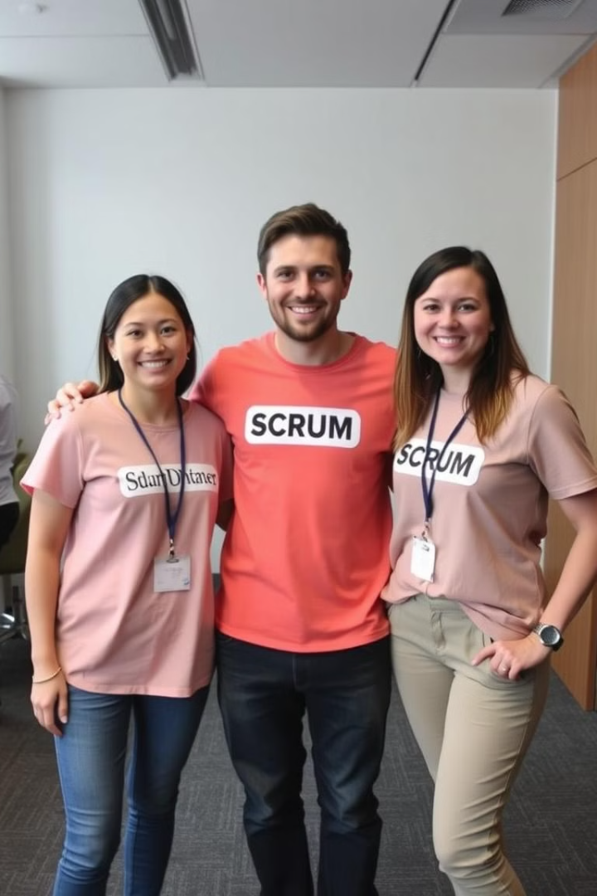
Scrum Roles
Product Owner
Scrum Master
Defines and prioritizes the Product Backlog to maximize product value.
Facilitates Scrum processes, removes impediments, and ensures adherence to Scrum practices.
Development Team
A cross-functional group responsible for delivering product increments.

Slide 5
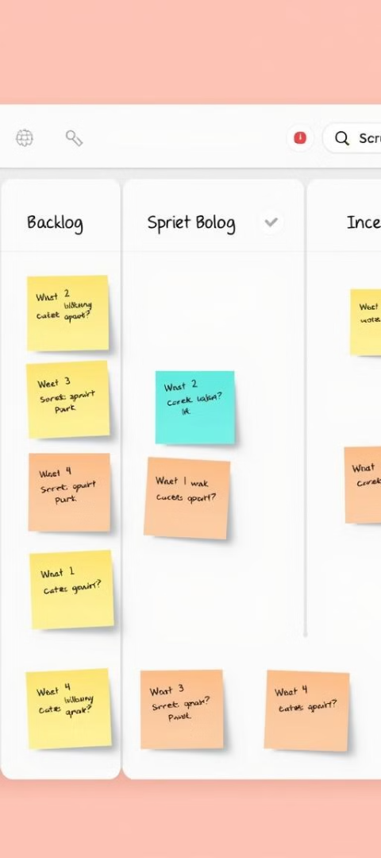



Scrum Artifacts
Product Backlog
Sprint Backlog
Increment
An ordered list of everything needed in the product, managed by the Product Owner.
A set of items selected from the Product Backlog for the current Sprint, plus a plan for delivering them.
The sum of all completed Product Backlog items during a Sprint, representing a potentially shippable product.

Slide 6
Scrum Events (Ceremonies)
Sprint
1
A time-boxed period (usually 2–4 weeks) where a set of work is completed.
2
Sprint Planning
A meeting to outline what will be done during the Sprint and how it will be achieved.
Daily Scrum (Stand-up)
3
A 15-minute daily meeting for the team to synchronize activities and plan for the next 24 hours.
4
Sprint Review
Held at the end of the Sprint to inspect the Increment and adapt the Product Backlog if needed.
Sprint Retrospective
5
A meeting for the team to reflect on the Sprint and identify areas for improvement.

Slide 7





Scrum Process Flow
Initiation
The Product Owner creates and prioritizes the Product Backlog.
Planning
During Sprint Planning, the team selects items from the Product Backlog to work on.
Execution
The Development Team works on the selected items during the Sprint, holding Daily Scrums to coordinate efforts.
Review
At the end of the Sprint, the team presents the Increment during the Sprint Review.
Retrospective
The team reflects on the Sprint to identify improvements for future Sprints.

Slide 8





Common Scrum Tools
Jira
Trello
Azure DevOps
Asana
A tool for tracking and managing Agile projects.
A visual project management tool using boards and cards.
A set of development tools for planning and collaboration.
A task management tool to help teams organize work.
Monday.com
A work operating system for managing workflows.

Slide 9

Challenges in Scrum
1
Cultural Shift
Transitioning to a Scrum framework requires a change in mindset and company culture.
2
Role Misunderstanding
Ensuring all team members understand their responsibilities is crucial.
3
Incomplete Backlogs
A well-defined Product Backlog is essential for effective Sprints.
4
Resistance to Change
Teams may face challenges adapting to new processes and practices.

Slide 10

Benefits of Scrum
1
Adaptability
Ability to respond quickly to changing requirements.
2
Transparency
Regular meetings and updates enhance visibility.
3
Continuous Improvement
Frequent retrospectives promote ongoing enhancements.
4
Customer Satisfaction
Regular delivery of valuable products increases stakeholder confidence.

Slide 11
Real-World Applications of Scrum
Software Development
Marketing
Companies like Microsoft and Google use Scrum to manage product development.
Teams apply Scrum to plan and execute marketing campaigns.
Education
Event Planning
Educational institutions use Scrum to develop curricula and manage projects.
Organizers implement Scrum to coordinate events and conferences.

Slide 12

Thank You
We hope this presentation provided a comprehensive overview of the Scrum framework and its benefits.

